Slide 1
Session 2: Introduction to Linux

Slide 2
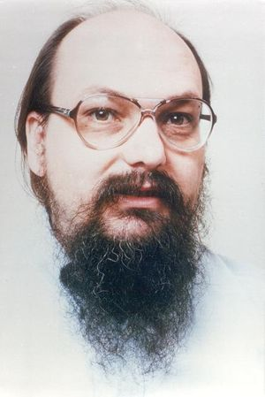
Unix
In 1969-1970, Kenneth Thompson, Dennis Ritchie, and others at AT&T Bell Labs began developing a small operating system on a little-used PDP-7 computer
The operating system was soon named Unix, a joke on an earlier operating system project called MULTICS (Bell Labs, MIT, GE)
In 1972-73, Unix was rewritten in C (a visionary and unusual step), which made it portable

Slide 3
Unix Progression
Two dominating versions emerged
Berkley Software Distribution (BSD)
AT&T
Many other mixed versions emerged later
Most of these were proprietary and were maintained by their respective hardware vendor
Example: Sun Solaris
FreeBSD, NetBSD, OpenBSD became open source

Slide 4
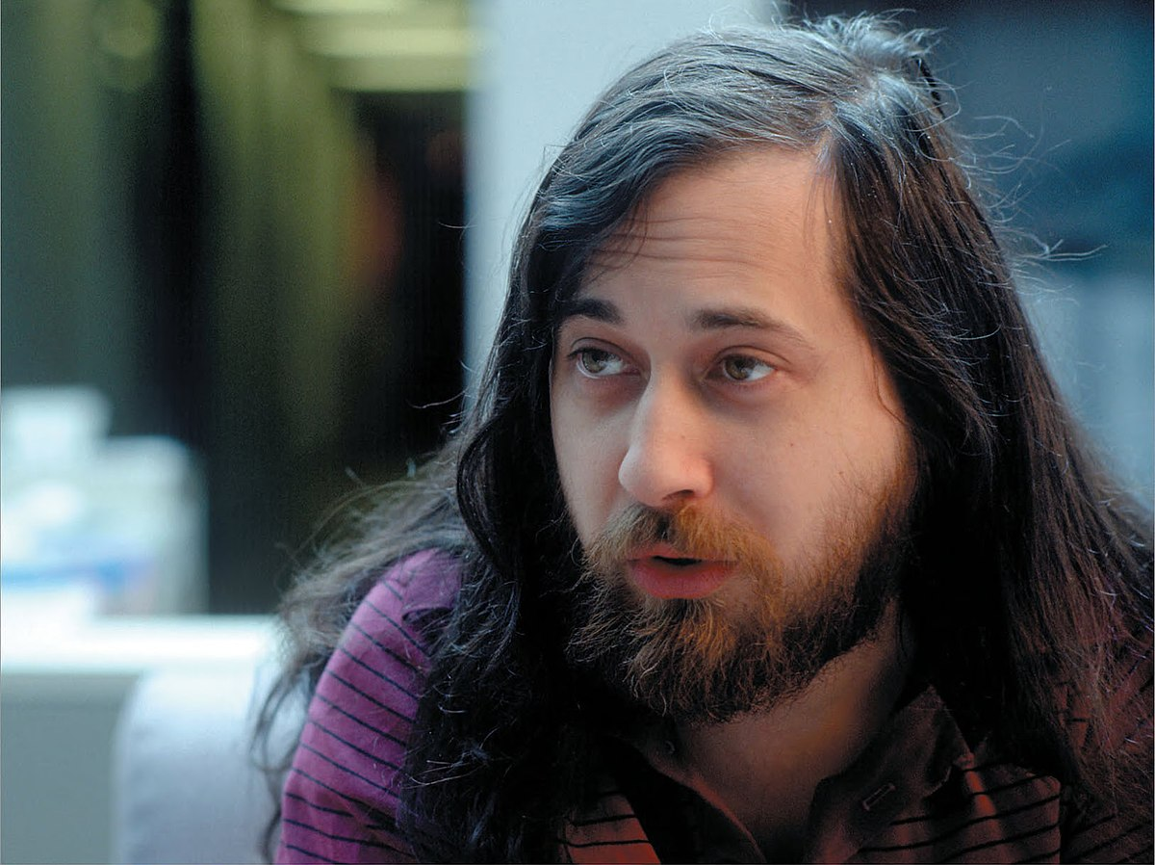
Free Software Foundation (FSF)
In 1984, Richard Stallman’s Free Software Foundation (FSF) began the GNU project, a project to create a free version of Unix (See next slide)

Slide 5

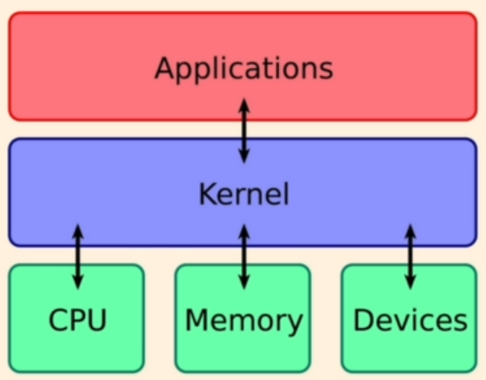
Linux History
A Finnish student Linus Torvalds started a personal project in 1991
He was trying to create a new free operating system kernel, which could work with the FSF material and some BSD components to create a very useful operating system
Memory management, Task scheduling, …
Kernel = Heart of an operating system, which facilitates interactions between hardware and software

Slide 6
Installing Linux – Multiple Options
On a Windows machine, install WSL (Simplest and light-weight)
https://learn.microsoft.com/en-us/windows/wsl/install
Use a virtual machine and install a Linux distribution
VMWare or Oracle VirtualBox (See https://techbland.com/how-to-install-lubuntu-on-virtualbox-on-windows/)
Create a dual-boot machine (Windows and Linux)

Slide 7
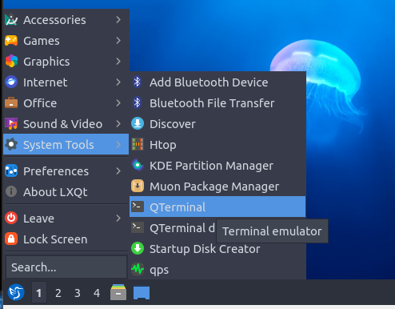
Making the screen larger
Click on the left bottom blue button, System tools, QTerminal

Slide 8
Installation …
sudo apt-get update
sudo apt install virtualbox-guest-x11 -y
Again click on the blue button, Leave, Reboot
Now if we use the maximize button (Right top), we should be able to see a full window of Lubuntu

Slide 9

Linux Distributions (“Distros”)
In the Linux community, different organizations have combined the available components differently.
Each combination is called a “distribution”, and the organizations that develop distributions are called “distributors”.
Common distributions include Red Hat, Mandrake, SuSE, Caldera, Corel, and Debian.
There are differences between the various distributions, but all distributions are based on the same foundation: the Linux kernel and the GNU glibc libraries.

Slide 10

Linux Command Line
Command line = Shell
Shell is a program that takes keyboard commands and passes them to the operating system for execution
Almost all Linux distributions support a shell program called bash
Bash = Bourne Again Shell (because bash replaces sh, the original Unix shell program written by Steve Bourne)
The name shell is given because it is the outer layer of the OS like the shell around an oyster (See next slide)

Slide 11
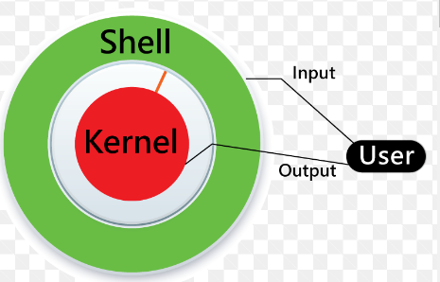
Linux Shell Concept
A shell is a Linux program that accepts user commands, interprets, and executes them

Slide 12
Different Linux Shells
Shell | Program Name | Description
Bourne shell | sh | Original shell program from AT&T, available on all UNIX systems
C shell | csh | Shell developed as a part of BSD UNIX
TC shell | tsh | Similar to csh, with some enhancements
Korn shell | ksh | AT&T’s improvement of the Bourne shell
Bourne Again Shell | bash | Shell distributed with Linux

Slide 13

The Shell Prompt
General format: username@machinename, followed by the current working directory, and a dollar sign
If we have a hash (#) at the end, instead of the dollar, the user has superuser/root privileges

Slide 14
Filesystem Tree
Like Windows, a Unix-like operating system such as Linux organizes its files in what is called a hierarchical directory structure.
This means that they are organized in a tree-like pattern of directories (sometimes called folders in other systems), which may contain files and other directories.
The first directory in the filesystem is called the root directory.
The root directory contains files and subdirectories, which contain more files and subdirectories, and so on.

Slide 15
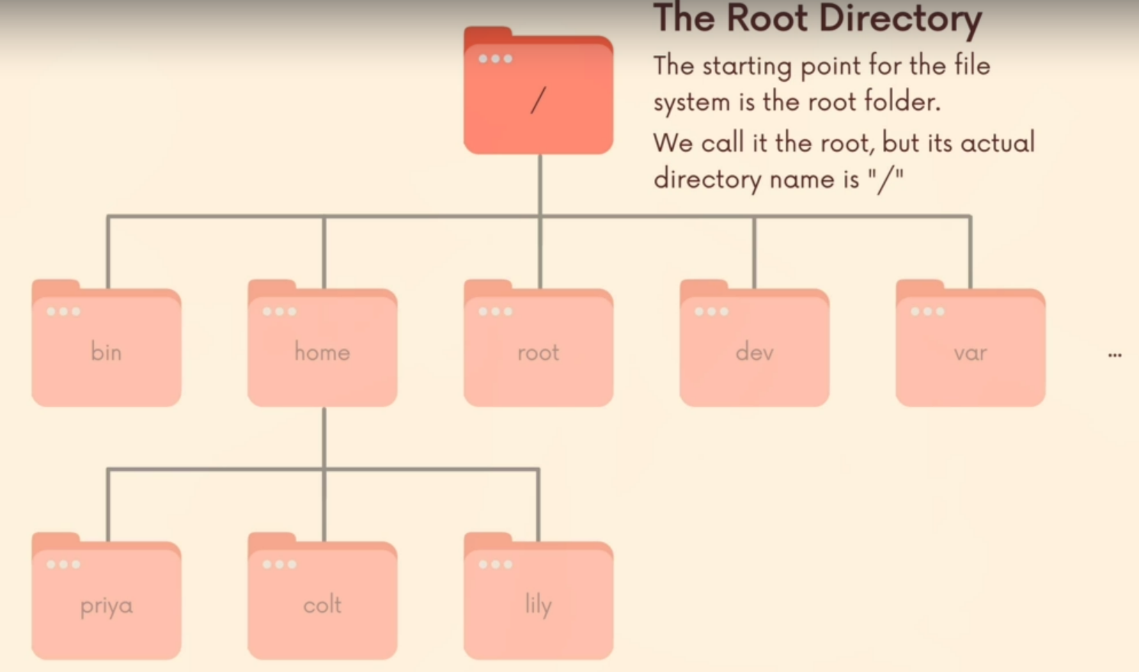
The Root Directory
Confusion!
The real root directory is /
There is also another directory named root within the real root (i.e. /). But this is not the real root. This is for a default user called as root.

Slide 16

The Current Directory
The pwd command (print working directory)
When we first log in to our system (or start a terminal emulator session), our current working directory is set to our home directory.
Each user account is given its own home directory, which is the only place the user is allowed to write files when operating as a regular user.

Slide 17
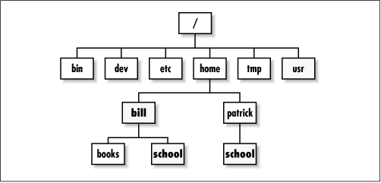
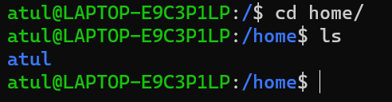
The Home Directory
Each user on the system has a sub-directory inside home

Slide 18
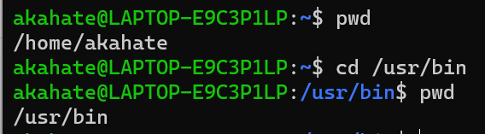
Other Directory Commands
ls: List the files and directories in the current working directory
cd: Change directory
Absolute path names: Begins with the root directory and follows the tree branch by branch until the path to the desired directory or file is completed.
For example, there is a directory on your system in which most of your system’s programs are installed. The pathname of that directory is /usr/bin

Slide 19
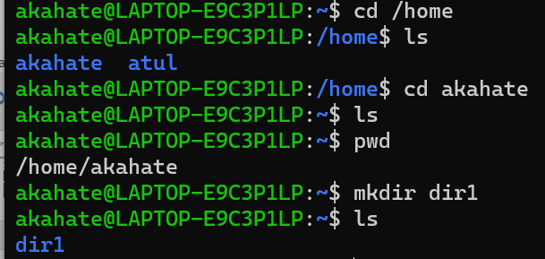
More Directory Commands
mkdir: Create a directory

Slide 20
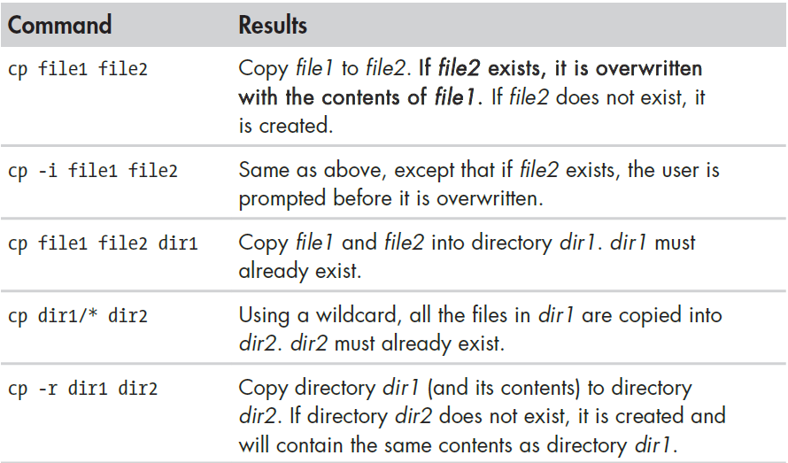
More Directory Commands
cp: Copy files and directories

Slide 21
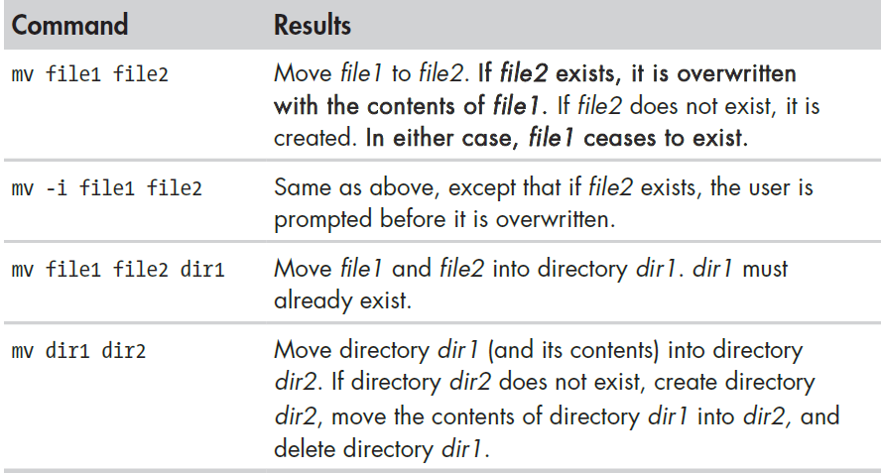
More Directory Commands
mv: Move and rename files

Slide 22
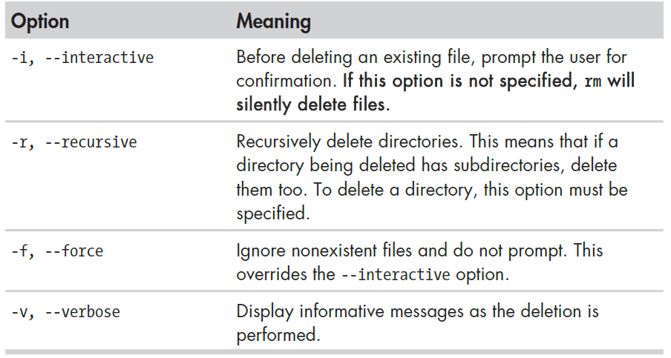
More Directory Commands
rm: Delete files and directories

Slide 23
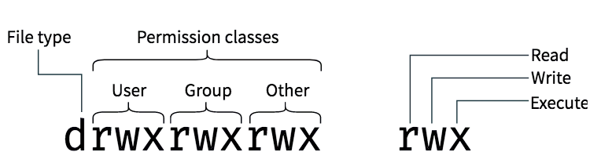
File Permissions

Slide 24
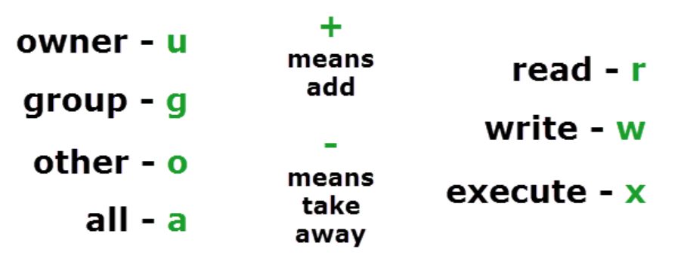
How to Specify Who to Give Permissions To?

Slide 25
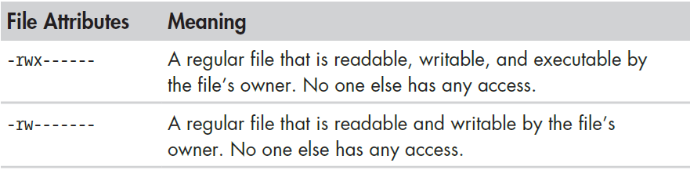
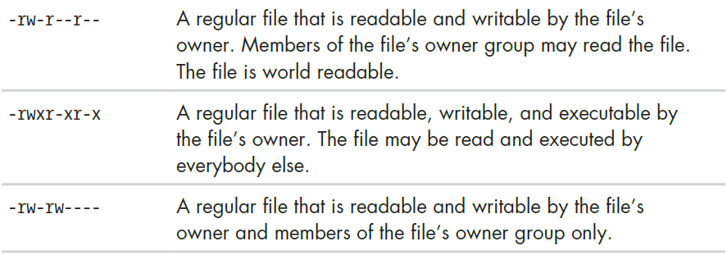
File Permission Examples

Slide 26
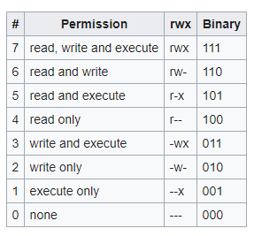
File Permissions in Binary

Slide 27
Understanding Numeric File Permissions
Remember, Read permission = 4, Write permission = 2, Execute permission = 1
Requirement | Character-based permissions | Numeric representation
Give all permissions to all the users | 4 + 2 + 1 for everyone | 777
Give read-write permissions to all the users | 4 + 2 for everyone | 666
Owner should have all the permissions, and the others should have read and execute permissions | 4 + 2 + 1 for the owner, 4 +1 for the others | 755

Slide 28
Examples
chmod 755 file1
chmod u+x file1
chmod 525 file1
chmod g-w file1

